Slide 1
Sentiment Analysis using Machine Learning Technique
-: Presented By :-
Pratik Akbari
(21IM60R01)
&
Harsh Vardhan Singh
(21IM60R02)
Master of Technology,
Department of Industrial & System Engineering,
IIT Kharagpur

Slide 2
Objective
To Build a Machine learning Model for sentiment analysis (SA).
To Train a ML model that can output if a Review is positive or negative.

Slide 3
Work Flow
1) Introduction to Sentiment Analysis (SA).
2) Data Collection (Twitter, Amazon Product Review)
3) Data Pre-Preparation (Tokenization, Lemmatization)
4) ML Model Building.
Model Training.
Model Validation & Testing.
5) Predict the nature of sentiment.
6) Results & Discussion.

Slide 4
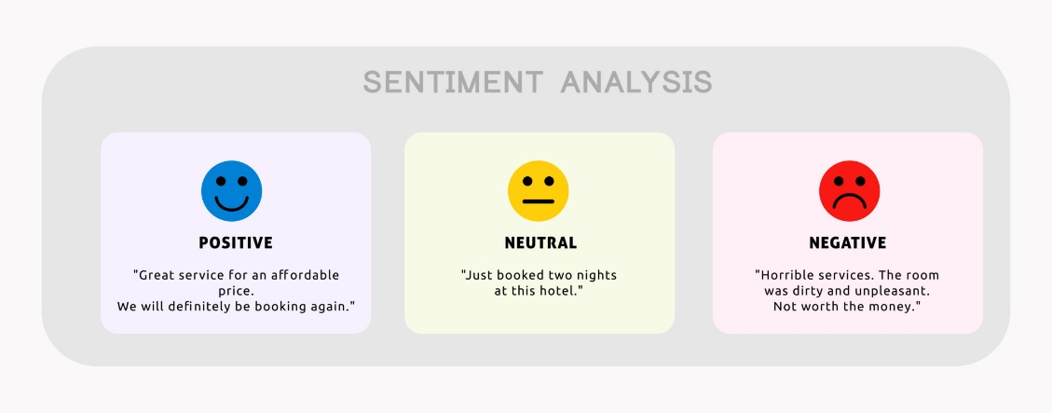
1. Introduction to SA
Natural language processing (NLP) technique used to determine whether data is positive, negative or neutral.
Sentiment analysis is the process of detecting positive or negative sentiment in text.

Slide 5
Introduction (Cont.)
Performed on textual data for text analysis to help businesses.
To detect sentiment in social data, gauge brand reputation, and understand customer’s feedback and needs.
Mostly perform on :
Public reviews,
Social media platforms,
Similar sites.

Slide 6
Important of Sentiment Analysis
Web 2.0 has led to the emergence of blogs, forums, and online social networks that enable users to discuss any topic and share their opinions about it.
Ex.: complain about a product that they have bought,
debate on any current issues,
express their political views.
To Analyzing customer responses and social media conversations, allows brands to learn what makes customers happy or frustrated.
To Detect disgruntled customers immediately.
Analysing public opinions : explains human activity and behavior.

Slide 7
Types of Sentiment Analysis
Focuses on the polarity of a text (positive, negative, neutral)
It also goes beyond polarity to detect :
Specific feelings and emotions (angry, happy, sad, etc),
Urgency (urgent, not urgent),
Even intentions (interested v. not interested).
Types of SA :
Graded Sentiment Analysis
Emotion Detection Sentiment Analysis
Aspect-based Sentiment Analysis

Slide 8
i) Graded Sentiment Analysis
Known as Fine-grained sentiment analysis.
To interpret 5-star ratings in a review.
If polarity precision is important to our business,
Very positive - 5 star
Positive
Neutral
Negative
Very negative - 1star

Slide 9

ii) Emotion detection
Emotion detection sentiment analysis allows us to go beyond polarity to detect emotions, like happiness, frustration, anger, and sadness.
This systems use ML algorithms or lexicons.

Slide 10
iii) Aspect-based Sentiment Analysis
Which particular aspects or features people are mentioning in a positive, neutral, or negative way.
Example : Product Review
"The battery life of this camera is too short”
Negative opinion about the battery life of the product.

Slide 11
Sentiment Analysis Challenges
Subjectivity & Tone
Context & Polarity
Irony & Sarcasm
Comparisons
Emoji's
Defining Neutral
Human Annotator Accuracy

Slide 12
Subjectivity and Tone
Two types of text: subjective and objective
Objective texts do not contain explicit sentiments, whereas subjective texts do
Example :
"The package is nice”.
“The package is red”
Sentiment is positive for the first one and neutral for the second one.

Slide 13
Context and Polarity
Analyzing sentiment without context gets pretty difficult.
machines cannot learn about contexts if they are not mentioned explicitly.
Example :
"Everything about it.
Absolutely nothing!
What did you like about the event?
What did you Dislike about the event?

Slide 14
Irony and Sarcasm
People express their negative sentiments using positive words
Machines cannot learn about contexts if they are not mentioned explicitly.
Example :
" Yeah, sure. So smooth!
Not one, but many!
Did you enjoy your shopping experience with us?

Slide 15
Comparisons
Comparisons in sentiment analysis is another challenge worth tackling.
Example :
" This product is second to none.
This is better than older tools.
This is better than nothing!

Slide 16
Sentiment Analysis Application
Social Media Monitoring
Brand Monitoring
Voice of customer (VoC)
Customer Service
Market Research

Slide 17
Area of Application
Social Media Monitoring
Twitter Sentiment Analysis
Reddit Sentiment Analysis
E-Commerce Monitoring
Amazon Product Review Sentiment Analysis
Financial News Sentiment Analysis
Brand Monitoring & Reputation Management

Slide 18
Working of Sentiment Analysis Approach
Different algorithms in sentiment analysis models, depending on :
How much data we need to analyze,
How accurate we need our model to be.
Sentiment analysis algorithms fall into one of three buckets:
Rule-based Approach
Automatic
Approach
Hybrid
Approach
(i)
(ii)
(iii)

Slide 19
i) Rule-Based Approaches
Uses a set of human-crafted rules to help identify subjectivity, polarity, or the subject of an opinion.
These rules may include various NLP techniques such as:
Stemming, tokenization, part-of-speech tagging and parsing.
Lexicons (i.e. lists of words and expressions).
Rule-based systems require fine-tuning and maintenance.

Slide 20



Working of Rule-Based system
Negative :
Bad,
Worst,
Ugly,
Etc..
Positive Sentiment
P N
Negative Sentiment
Positive :
Good,
Best,
Beautiful,
Etc..
P N
Given Text
Neutral Sentiment
P N

Slide 21
ii) Automatic Approaches
This Systems rely on “machine learning techniques” to learn from data.
Automatic methods, contrary to rule-based systems.
A sentiment analysis : classification problem, whereby a classifier is fed a text and returns a category, e.g. positive, negative, or neutral.
Working of ML Algorithm :
1) Training part
2) Prediction part

Slide 22
Working of Training
Machine Learning Algorithm
TAG
(Positive, Neutral, Negative)
Feature Extractor
Features
Text
Test samples

Slide 23
Working of Prediction
Classifier Model
Feature Extractor
Features
Text
Predicted
TAG
(Positive, Neutral, Negative)

Slide 24
Feature Extraction Process
Pre-Processing Text
Feature Engineering
Bag of word
Steps Involved :
Accumulation
Tokenization
Pre-Processing Or Cleaning
Classification
Tokenization
Removing Stop-word
TF-IDF
Stemming
And Lemmatization
Word Embedding
Model Evaluation
Model Building

Slide 25
The Movie was great!
Converting text into tokens before transforming it into vectors.
Step 1:
Tokenization
Tokenization
The 01
Movie 02
was 03
Great 04
! 05

Slide 26
The Movie was great!
Cleaning the Data And Removing Stop words
Step 2:
Pre-Processing Text
Remove The special characters
The
Movie
was
Great
!

Slide 27
The Movie was great!
Classified the text in nature of sentiment
Step 3:
Classification
Positive +1
Negatve -1
Netural 0
The
Movie +/-
was
Great +/-
!

Slide 28
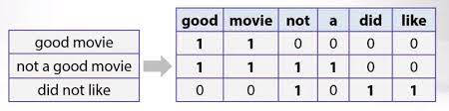
BAG OF WORDS:
For Each Token it will have a Feature Column
Feature Extraction
text-preprocessing
create a vocabulary
matrix of features
Text Vectorization

Slide 29
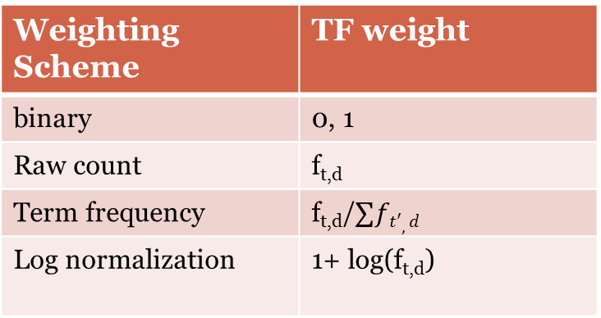
TF-IDF(term frequency-inverse document frequency):
Term Frequency(TF)-
Tf(f,d)-Frequency for term (or ngram) t in document d
Variants
:
Feature Extraction
Weighting Scheme | TF weight
binary | 0, 1
Raw count | f_{t,d}
Term frequency | f_{t,d}/$∑ft′,d$
Log normalization | 1+ log(f_{t,d})

Slide 30
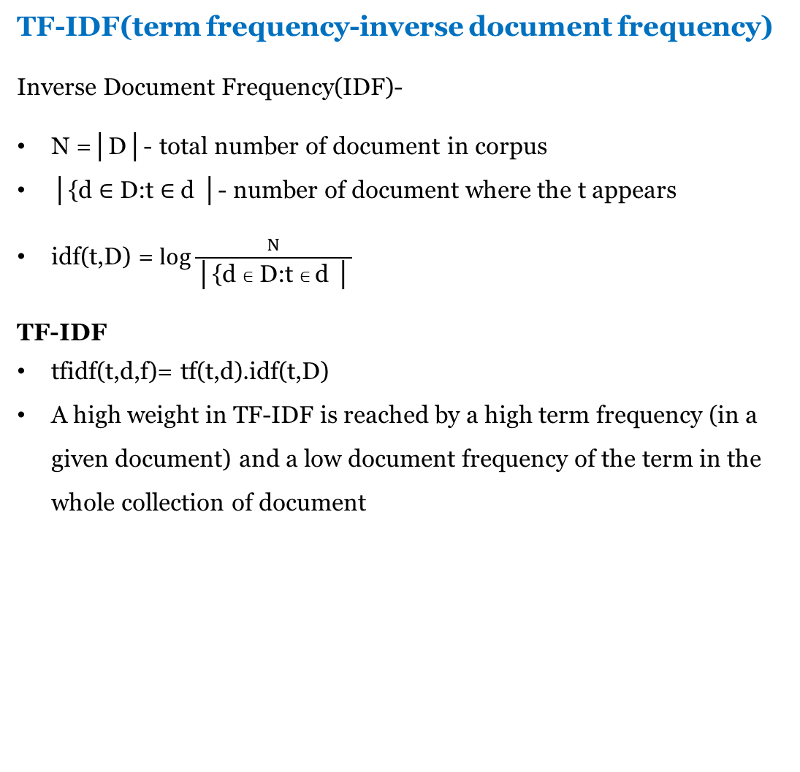
TF-IDF(term frequency-inverse document frequency)
Inverse Document Frequency(IDF)-
N =│D│- total number of document in corpus
│{d $∈$ D:t $∈$d │- number of document where the t appears
idf(t,D) = $\log{\frac{N}{\text{│\{}\text{d} ∈ \text{D}\text{:}\text{t} ∈ \text{d}\text{ │}}}$
TF-IDF
tfidf(t,d,f)= tf(t,d).idf(t,D)
A high weight in TF-IDF is reached by a high term frequency (in a given document) and a low document frequency of the term in the whole collection of document
Feature Extraction

Slide 31
2. Data Collection
Research Paper :
Dang, N.C., Moreno-García, M.N. and De la Prieta, F., 2020. Sentiment analysis based on deep learning: A comparative study. Electronics, 9(3), p.483.
Social Media Monitoring
Twitter /Reddit Sentiment Analysis
E-Commerce Monitoring
Amazon Product Review Sentiment Analysis

Slide 32
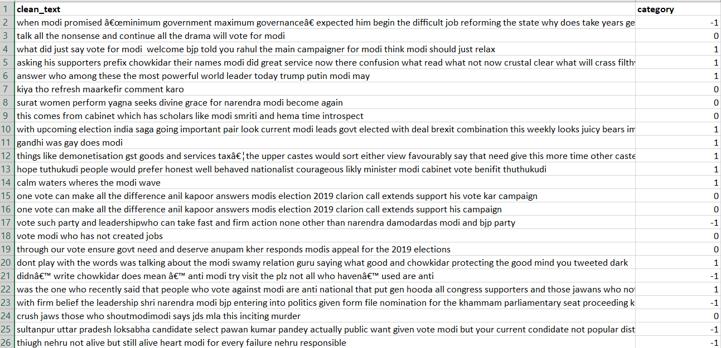
Twitter Dataset
Source : https://www.kaggle.com

Slide 33
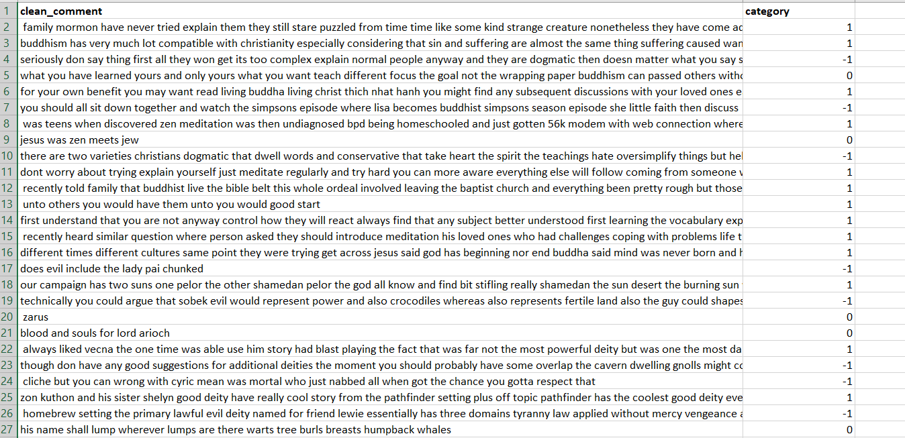
Reddit Dataset
Source : https://www.kaggle.com

Slide 34
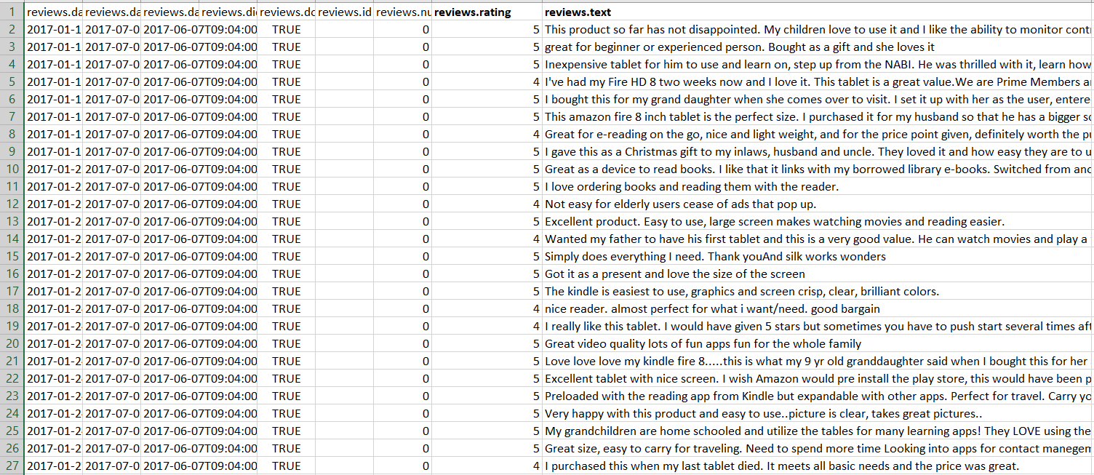
Amazon Product Review Dataset
Source : https://www.kaggle.com

Slide 35
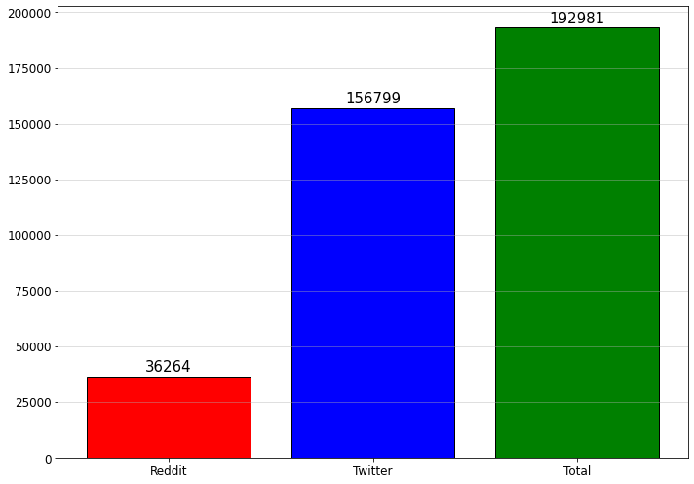
Data Visualization : Total no. of comment
Twitter/Reddit Dataset :

Slide 36
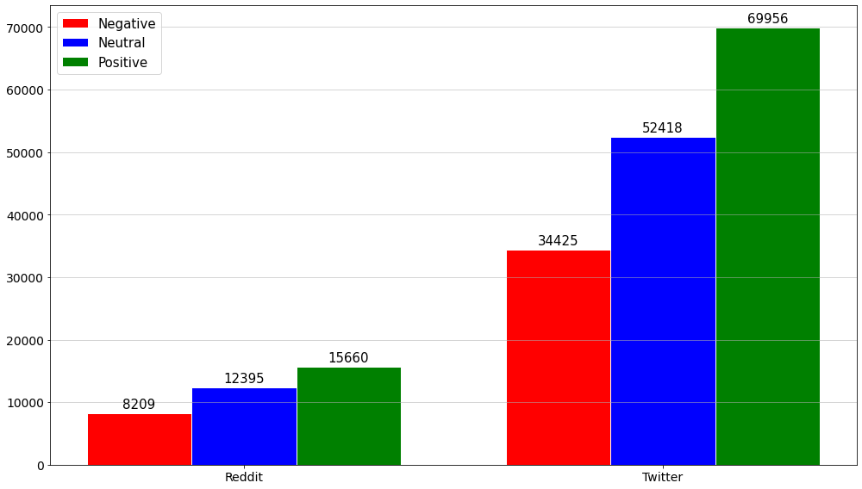
Positive, Negative and Neutral comment
Twitter/Reddit Dataset :

Slide 37
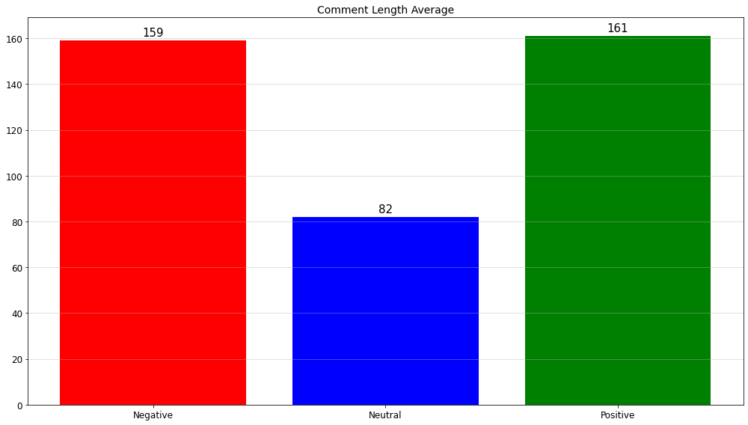
Average Length of Comment
Twitter/Reddit Dataset :

Slide 38
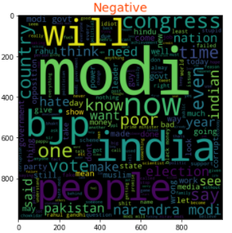
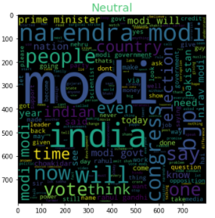
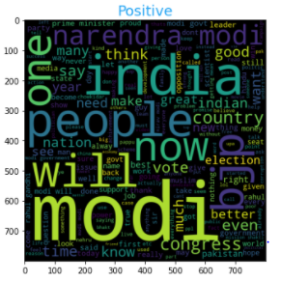
Word clouds for Nature of comment
Twitter/Reddit Dataset :

Slide 39
3. Data Extraction and Cleaning
Text Training data to be cleaned before being used to induce a classification model.
Word embedding
Stop words removing
Term Frequency-Inverse Document Frequency (TF-IDF)
Lemmatization
Tokenization

Slide 40
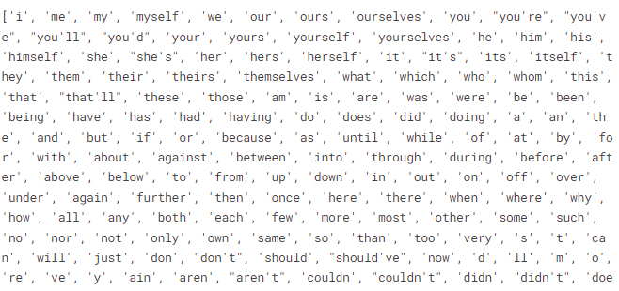
Stop words Removing
English Stop words list :

Slide 41

Lemmatization and Tokenization
Lemmatization :
Groups together different inflected forms of a word called lemma.
Output of Lemmatization is a proper word.
For example:
“Gone, Going, And Went Into Go”
Tokenization :
The process of splitting the sentences into smaller unit i.e. tokens
The most common type of tokenization is white space tokenization

Slide 42
Split Training and Testing Data
To employ a machine learning algorithm, we need to provide a training dataset to train the model.
For Model building purpose in ML for Twitter/Reddit Dataset :
Training data : 75% of the total data.
Testing data : 25% of the total data.

Slide 43
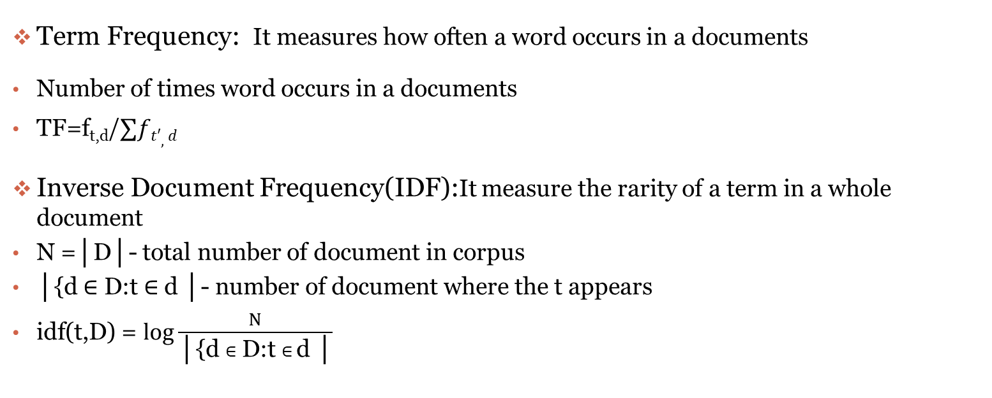
Term Frequency-Inverse Document Frequency (TF-IDF)
Term Frequency: It measures how often a word occurs in a documents
Number of times word occurs in a documents
TF=f_{t,d}/$∑ft′,d$
Inverse Document Frequency(IDF):It measure the rarity of a term in a whole document
N =│D│- total number of document in corpus
│{d $∈$ D:t $∈$d │- number of document where the t appears
idf(t,D) = $\log{\frac{N}{\text{│\{}\text{d} ∈ \text{D}\text{:}\text{t} ∈ \text{d}\text{ │}}}$

Slide 44
Term Frequency-Inverse Document Frequency (TF-IDF)
Term Frequency-Inverse Document Frequency
train_X= 95913 train_X_vectors= 95913, 78228
test_X= 31971 test_X_vectors= 31971, 78228
train_X_vectors
test_X_vectors

Slide 45
Training and Testing Dataset
Comments
Category
Train_X_Vectors (95913,78228) | Train_Y (95913)
Test_X_Vectors (31971,78228) | Test_Y (31971)
Training Set
Testing Set

Slide 46
4. ML Model Building
Machine Learning Algorithms for SA :
K-Nearest Neighbours (K-NN)
Naive Bayes
Decision Tree Classifier
Gradient Boosting
Support Vector Machine (SVM)

Slide 47
1. K-Nearest Neighbours (K-NN)
K-NN algorithm can be used for Regression as well as for Classification
This Method assumes the similarity between the new data and available Data and put the new Data into the category that is most similar to the available categories.
Working :
Select the number K of the neighbors
Calculate the Euclidean distance of K number of neighbors
Take the K nearest neighbors as per the calculated Euclidean distance.
Among these k neighbors, count the number of the data points in each category.
Assign the new data points to that category for which the number of the neighbor is maximum.

Slide 48
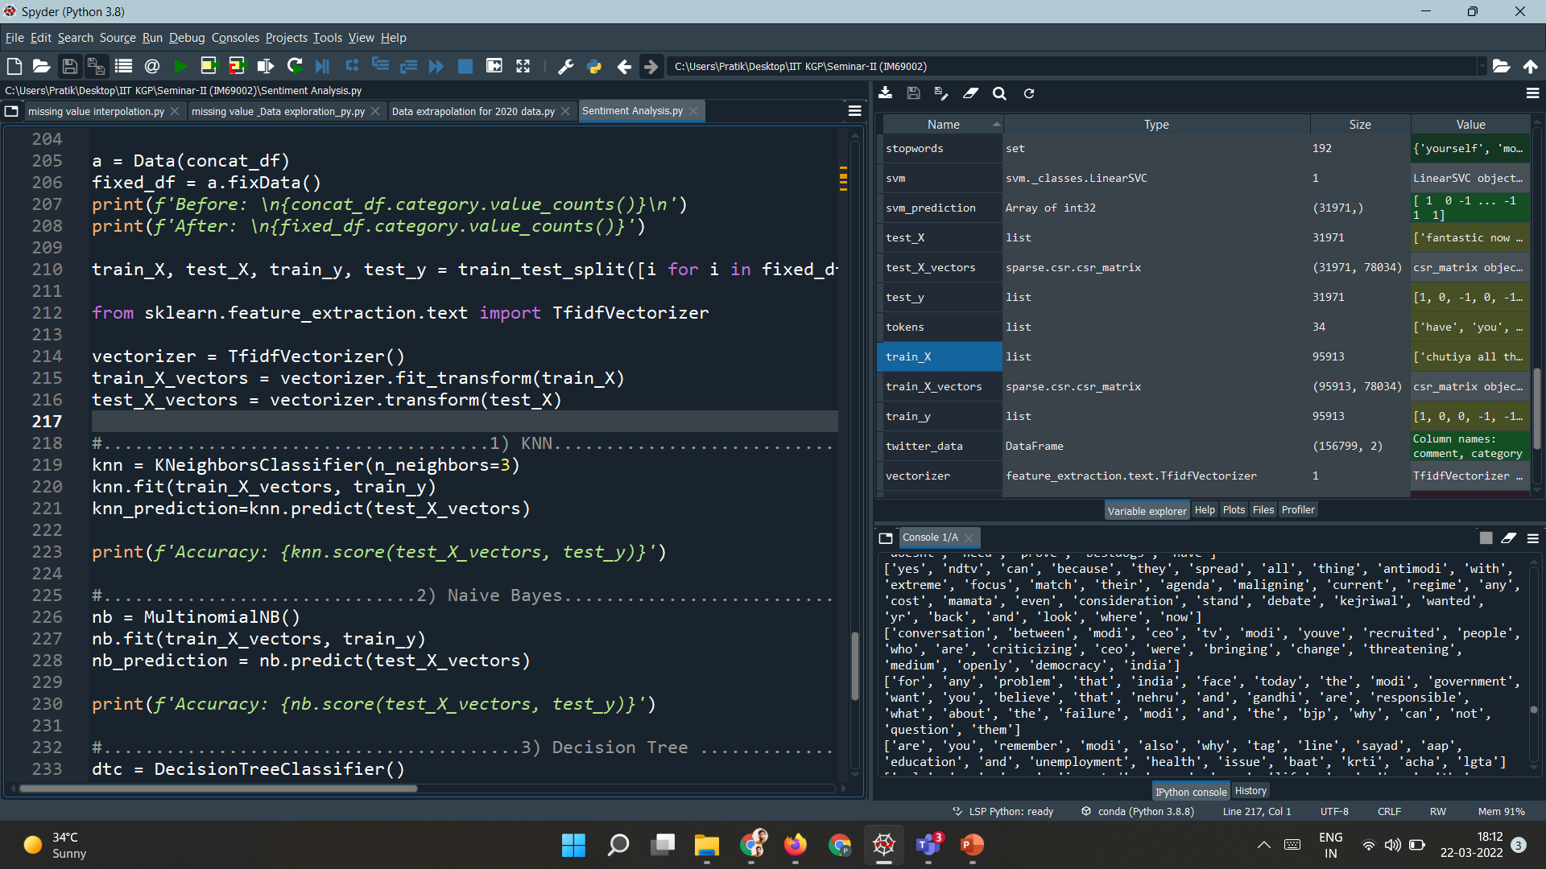
1. K-Nearest Neighbours (K-NN)
KNN Model Building :
Training the Model :
Testing the Model :
Model Accuracy :
46.73

Slide 49
2. Naive Bayes
Probabilistic classifier which is based on probability models that incorporate strong independence assumptions.
Fastest classification algorithm for a large chunk of data.
There are 3 types of Naive Bayes algorithm :-
Gaussian Naive Bayes | Multinomial Naive Bayes | Bernoulli Naive Bayes
This algorithm uses the Multinomial distribution.
Working :
This algorithm guesses the tag of a given text as training set, such as an twitter comment, using the Bayes theorem.
Calculates each tag's likelihood for a given sample and outputs the tag with the greatest chance.

Slide 50
2. Naive Bayes
NB Model Building :
Training the Model :
Testing the Model :
Model Accuracy :
70.04

Slide 51
3. Decision Tree Classifier
Supervised learning technique that can be used for both classification and Regression problems, but mostly it is preferred for solving Classification problems.
A decision tree can contain categorical data (YES/NO) as well as numeric data.
It is a tree-structured classifier, where
Internal nodes :--> Represent the features of a dataset,
Branches :--> Represent the decision rules,
Leaf node :--> Represents the outcome.
The decisions or the test are performed on the basis of features of the given dataset.

Slide 52

3. Decision Tree Classifier
DT Model Building :
Training the Model :
Testing the Model :
Model Accuracy :
77.44

Slide 53
4. Gradient Boosting (XGBoost)
XGBoost is a popular and efficient open-source implementation of the gradient boosted trees algorithm
supervised learning algorithm
This process slowly learns from the data and tries to improve its prediction in subsequent iterations.
It uses a gradient descent algorithm to minimize the loss when adding new models.

Slide 54

4. Gradient Boosting (XGBoost)
XGBoost Model Building :
Training the Model :
Testing the Model :
Model Accuracy :
83.69

Slide 55

5. Support Vector Machine (SVM)
SVM is a supervised machine learning algorithm that Classification is predicting a label.
SVM performs classification by finding the hyper-plane that differentiate the classes plotted in n-dimensional space.
Used for both classification or regression challenges.

Slide 56

5. Support Vector Classifier (SVC)
SVM Model Building :
Training the Model :
Testing the Model :
Model Accuracy :
92.48

Slide 57
Results & Discussion
Model Name | Accuracy
K-Nearest Neighbours (K-NN) | 46.73
Naive Bayes | 70.05
Decision Tree Classifier | 77.44
Gradient Boosting (XGBoost) | 83.69
Support Vector Machine (SVM) | 92.48

Slide 58
References
Ain, Q.T., Ali, M., Riaz, A., Noureen, A., Kamran, M., Hayat, B. and Rehman, A., 2017. Sentiment analysis using deep learning techniques: a review. Int J Adv Comput Sci Appl, 8(6), p.424.
Dang, N.C., Moreno-García, M.N. and De la Prieta, F., 2020. Sentiment analysis based on deep learning: A comparative study. Electronics, 9(3), p.483.
Dang, C.N., Moreno-García, M.N. and De la Prieta, F., 2021. Hybrid Deep Learning Models for Sentiment Analysis. Complexity, 2021.

Slide 59
THANK YOU

